Slide 1
Visualizations for journalist
Nairobi, 28 May 2014

Slide 2
At the end of this session you will be able to:
Create charts in excel.
Create interactive charts and graphs for the web using online tools.

Slide 3
EXCEL WITH EXCEL

Slide 4

Journalistic use of excel charts
Data analysis – seeing trends.
Showcasing data when pitching to editor.
Gives graphic designer better understanding of how you want the data to appear than spreadsheet alone.
!

Slide 5
CREATING EXCEL CHART

Slide 6
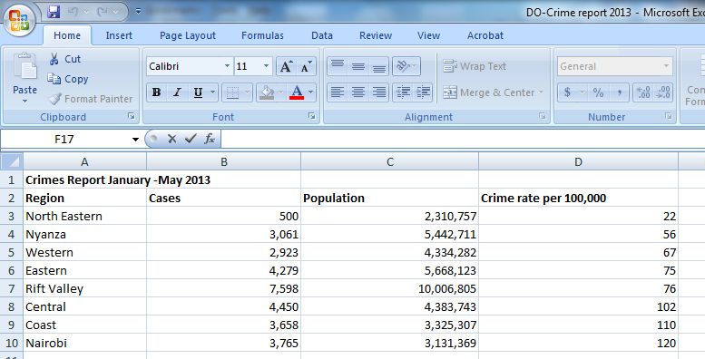
Open DO Crime report 2013

Slide 7
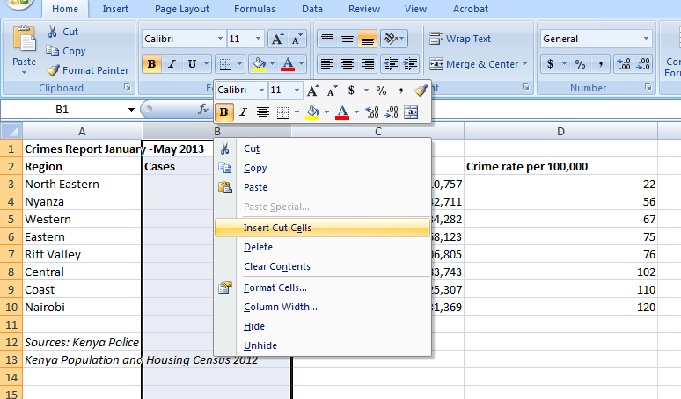
Move crime rate next to region

Slide 8
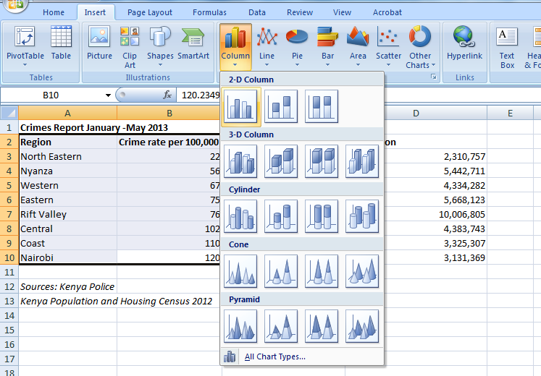
Select data, Insert chart

Slide 9
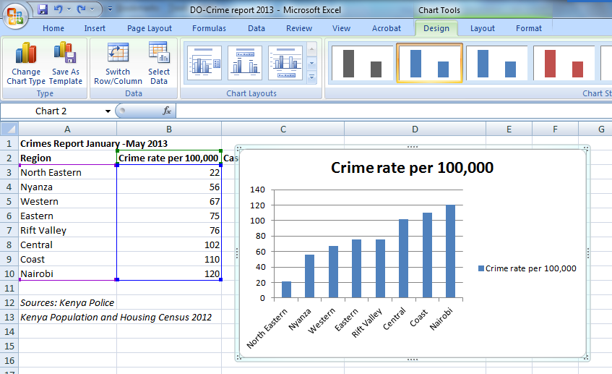
Result

Slide 10
CREATING INTERACTIVE CHARTS

Slide 11
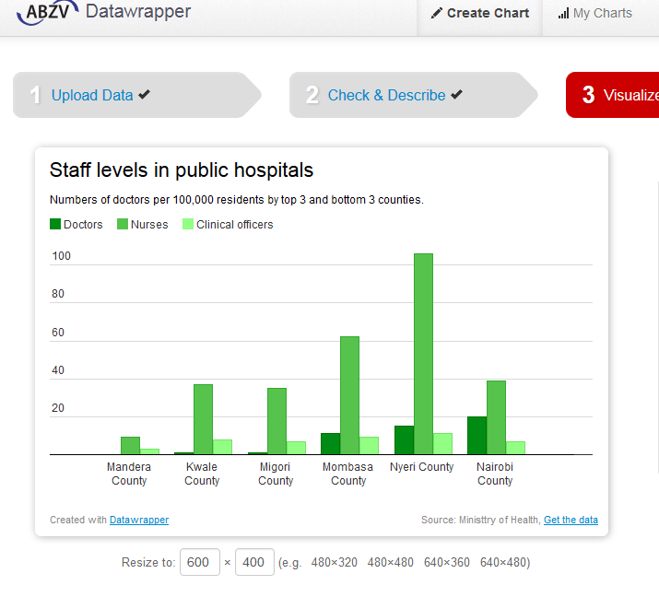
datawrapper.de
Pro
Easy, just drag and drop
Interactive graphs
Works on low bandwidth
Con
Only for small data sets
No Filters
Labeling limitations

Slide 12
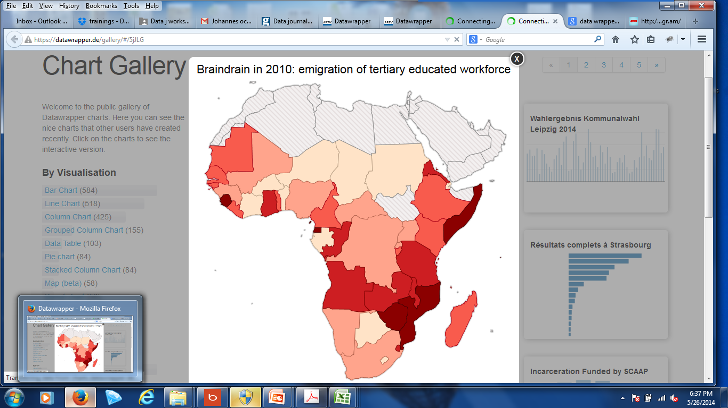
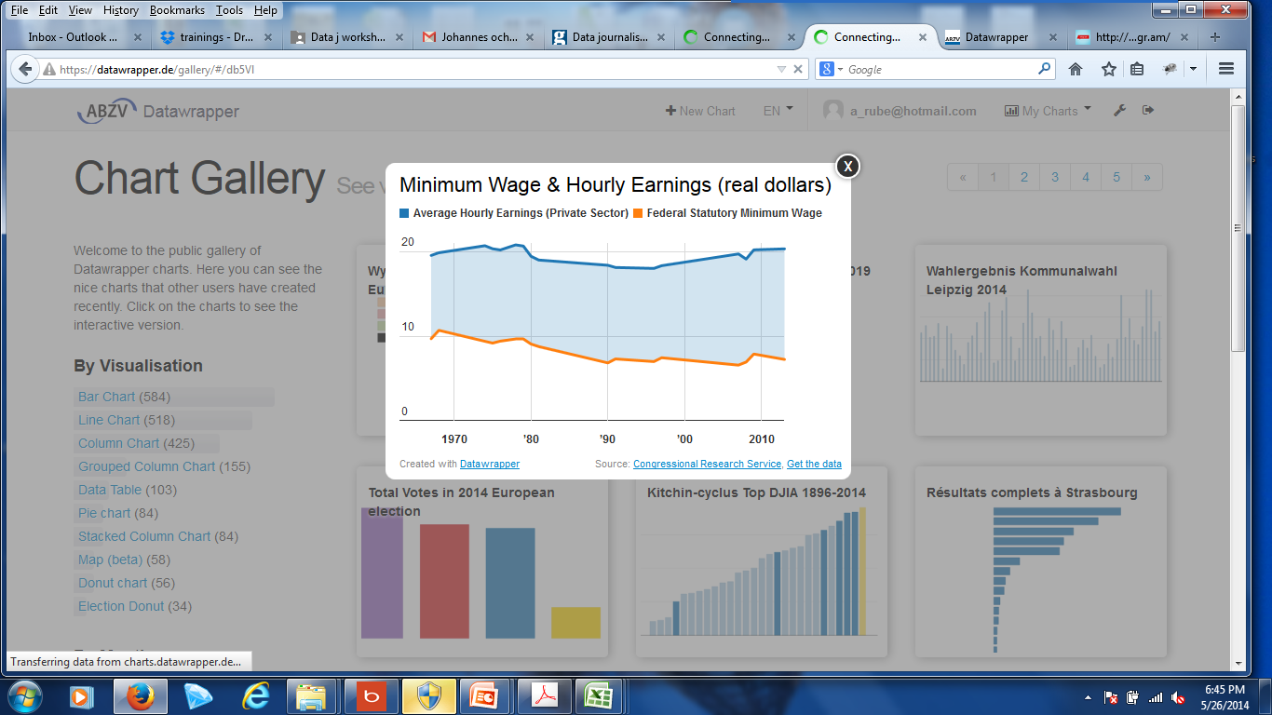

Slide 13
LETS GET TO WORK!

Slide 14
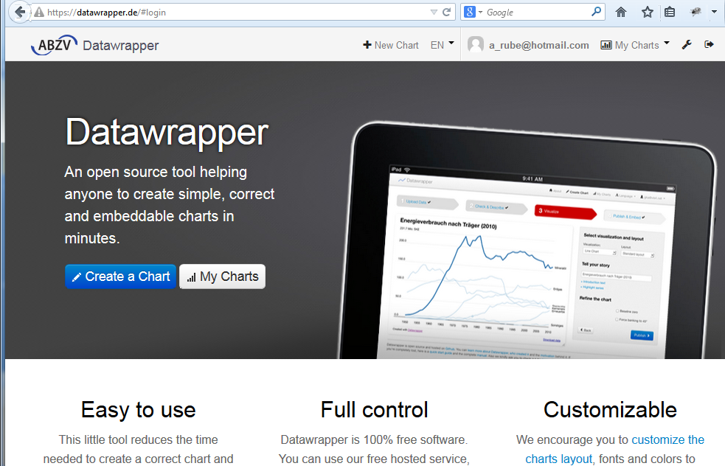
Register & Login www.datawrapper.de

Slide 15
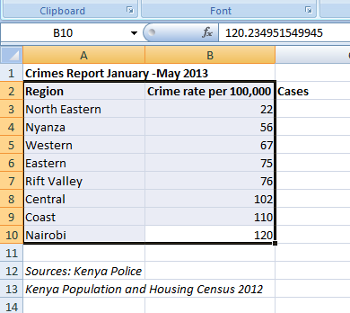
Get your data
Select the data you want to visualize from the spreadsheet in Excel.
Right click (or just crl+C) to copy the data

Slide 16
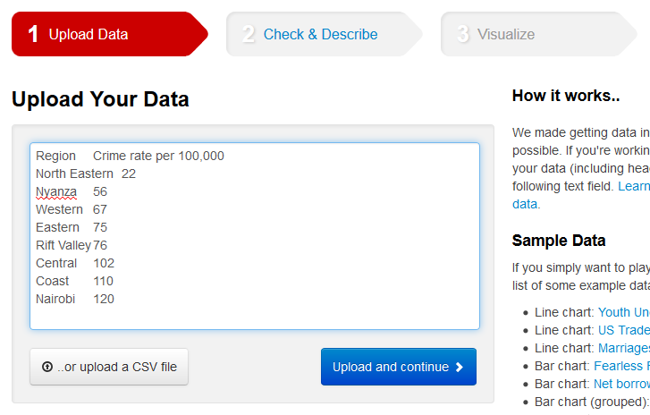
Past into data wrapper

Slide 17
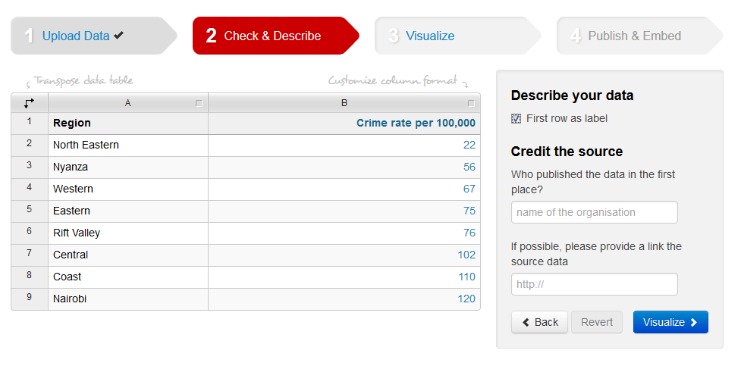
Add source

Slide 18
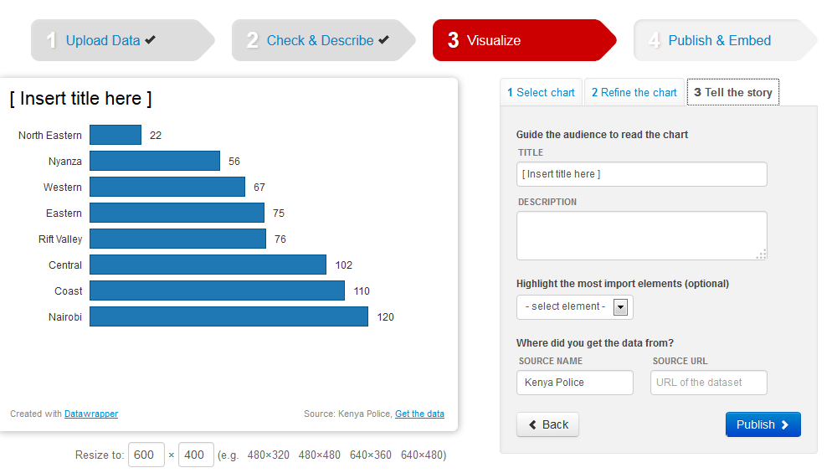
Add title and description

Slide 19
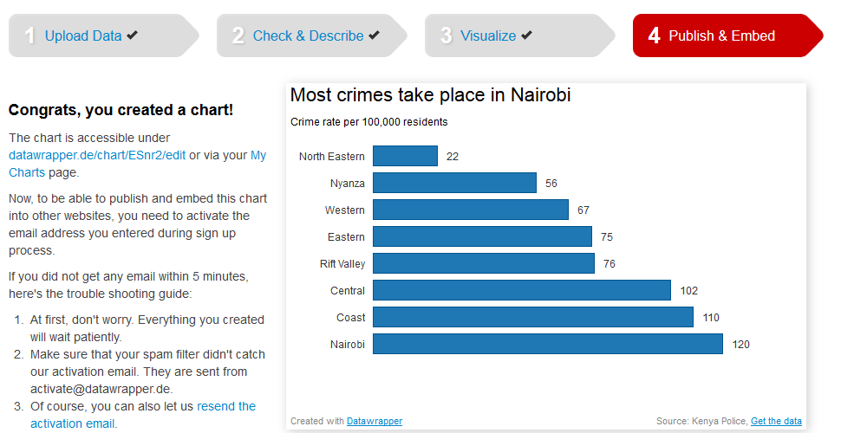
Ready for embedding!

Slide 20
Exercise
Make a pie chart using data wrapper of the distribution of crime cases per region.

Slide 21
REVIEW OF OTHER PROGRAMS

Slide 22
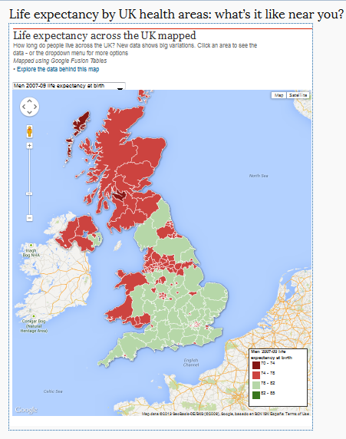
Google Fusion (accessed through gmail)
Pro
Merges geographical boundaries with data
User-friendly interactive mapping
Can embed charts in maps
Con
Advance functions require coding
Requiring accurate boarder files

Slide 23
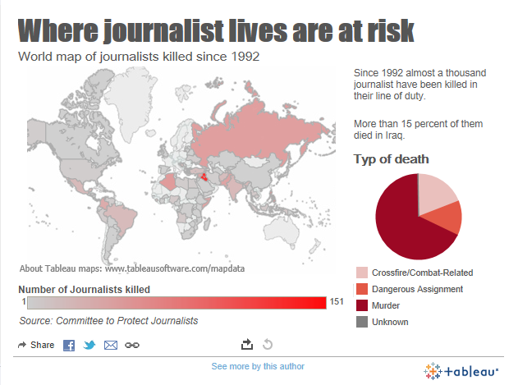
Tableausoftware.com
Pro
Accepts big data
Wide range of charts/filters
Combines maps and charts
Can produce multi media
packages
Con
Takes time to master interface
Picky on data format
Does not recognize counties

Slide 24
Infogr.am
Pro
Pictorial charts
Funky design
Con
Does not accept big data
Data is made public
Free version can only embed

Slide 25
INFOGR.AM CHART STEP BY STEP

Slide 26

Register (www.infogr.am)

Slide 27
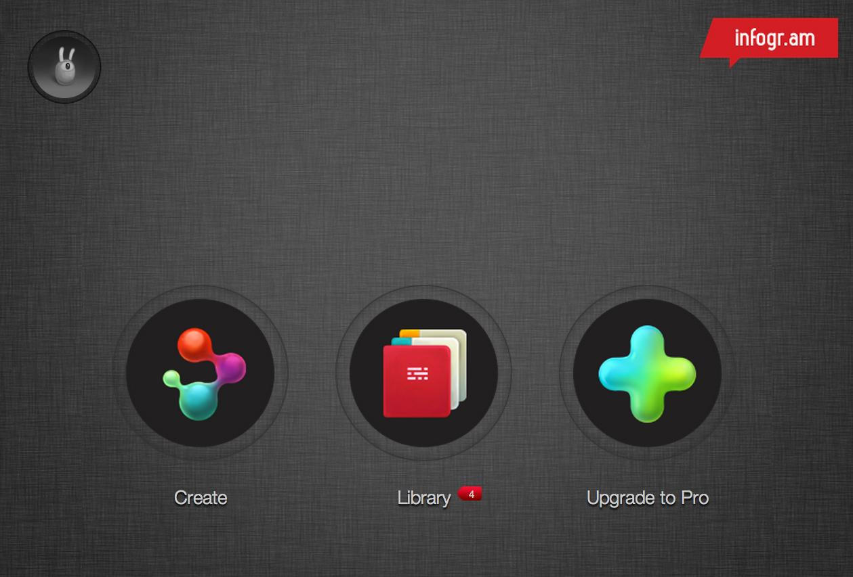
Go to create

Slide 28
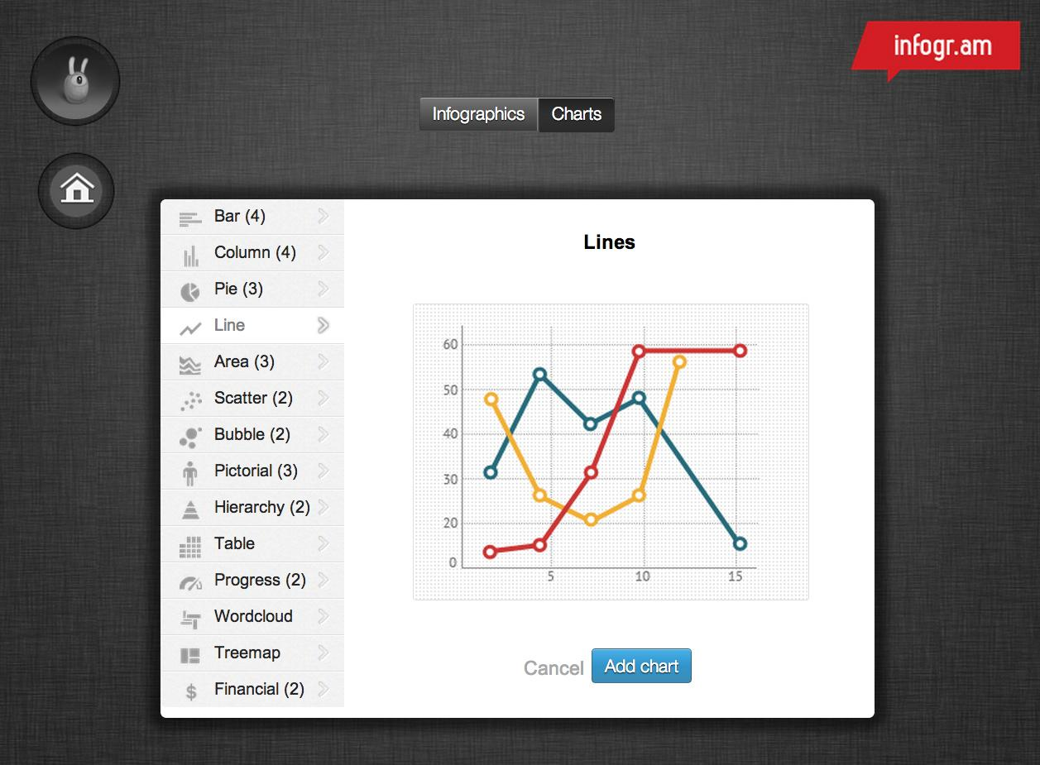
Choose a chart

Slide 29
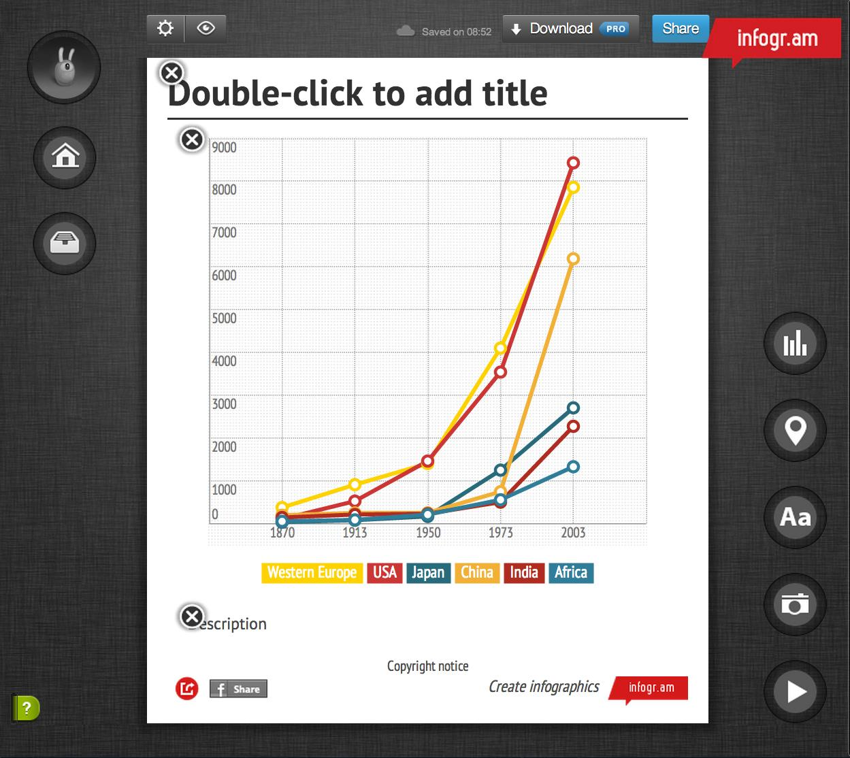
Double click on the graph to edit
Profile
Home
Library
Add a chart
Add map
Add text
Add a photo
Add a video
Here

Slide 30

Download “EA_life_expectancy_at_birth.xlsx”
http://bit.ly/17rz0Lc
When you use you own data make sure
it is formatted in the same way
as the infogr.am dummie data.
!

Slide 31
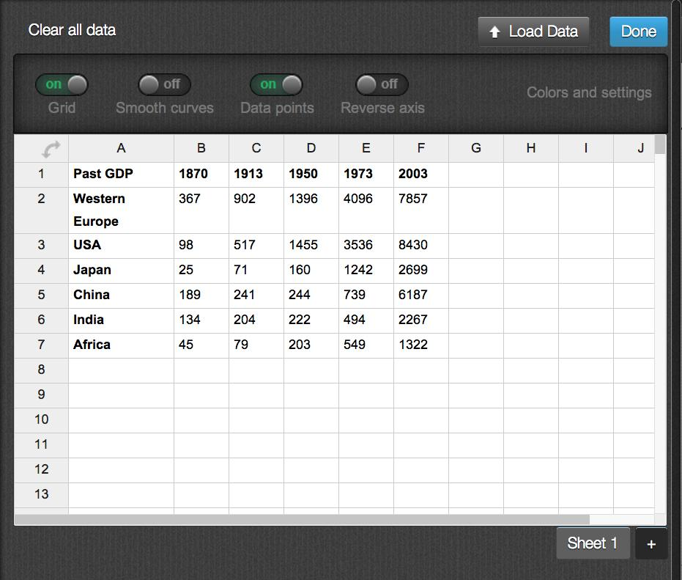
Adding the data
Click here
Click on Load data
Select the your spreadsheet in the pop-up window
Click on Done

Slide 32
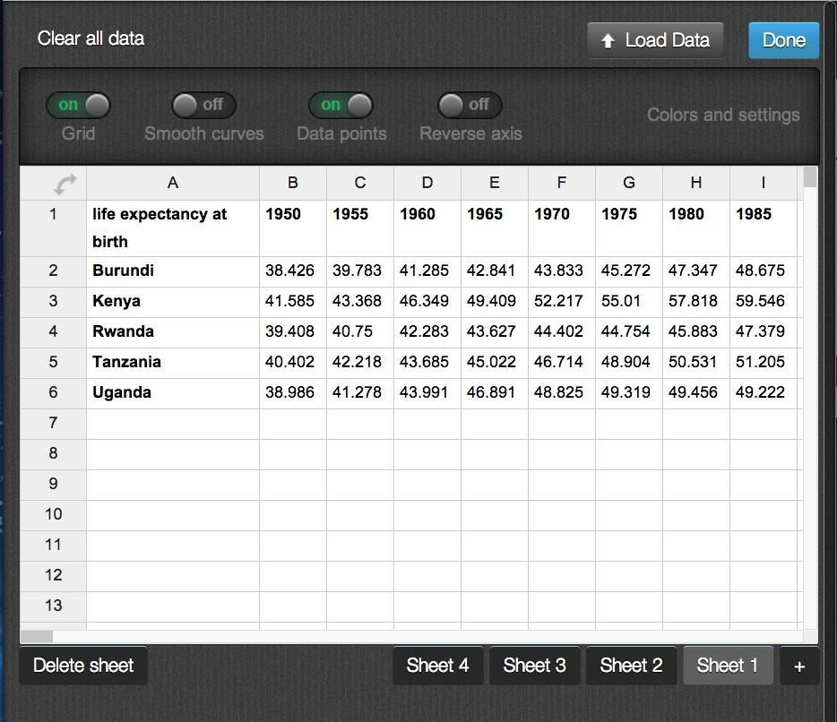
Delete unwanted sheets
Select and delete Sheet 4, 3, and 2 which contains sources of data etc (one at a time)
Select

Slide 33
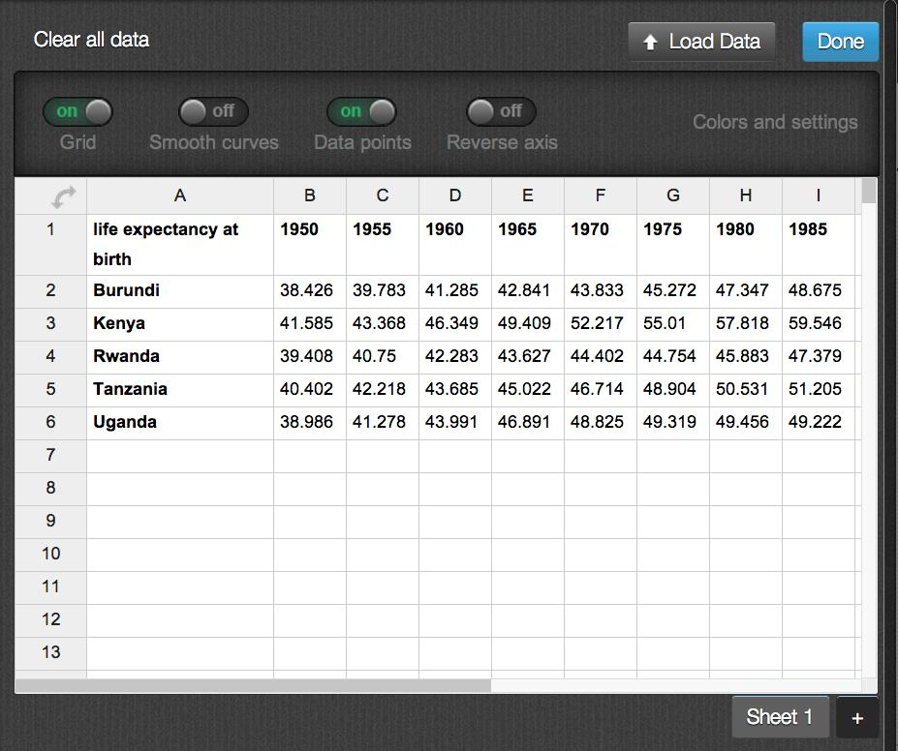
Adjust colors & labels
Click on Colors and settings

Slide 34
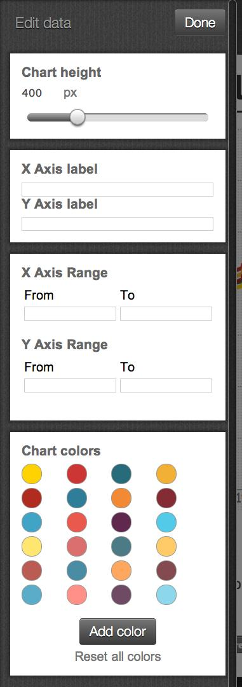
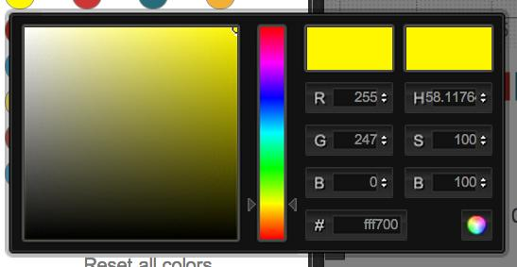
Adjust colors & labels
Click on the color of the palette to edit
Put in RGB/HSB or web color RGB code
Add “years” as the label of the Y axis

Slide 35
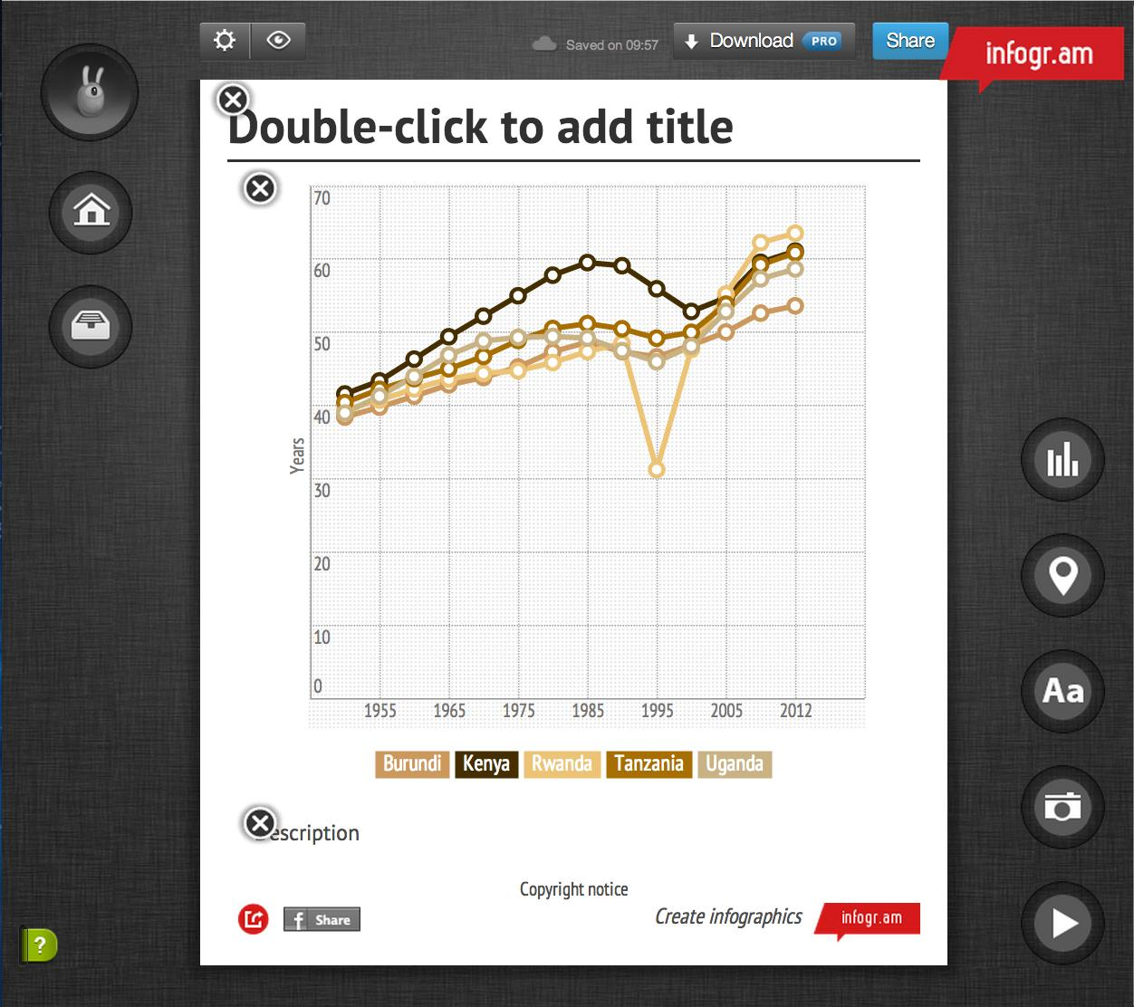
Adjusting text & headlines
Change or delete the graphs text and headlines.

Slide 36
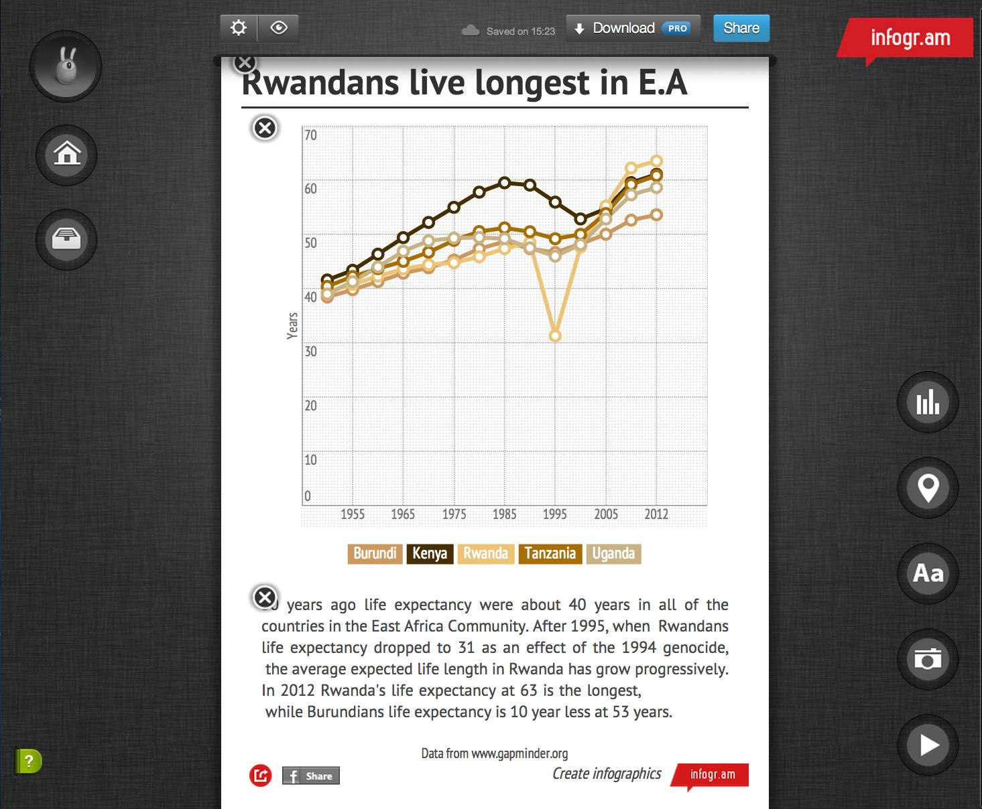
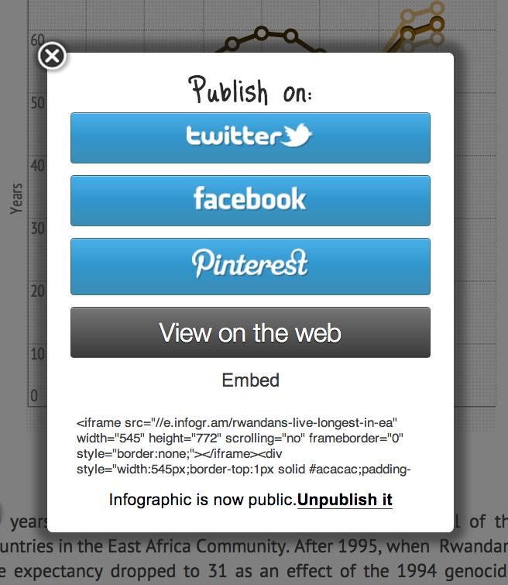
Publish to web
Click here
When you click on the share button you will get an dialog window
Choose prefered platform or web

